Slide 1
Chapter 5: Process Scheduling
March, 2021

Slide 2
Chapter 5: Process Scheduling
Basic Concepts
When does scheduling happen?
Scheduling Criteria
Scheduling Algorithms

Slide 3
Objectives
To introduce CPU scheduling, which is the basis for multi-programmed operating systems
To discuss evaluation criteria for selecting a CPU-scheduling algorithm for a particular system
To describe various CPU-scheduling algorithms

Slide 4
Basic Concepts
Process scheduling
Thread scheduling
CPU scheduling
Core scheduling

Slide 5
Basic Concepts
Maximum CPU utilization obtained with multiprogramming
CPU–I/O Burst Cycle – Process execution consists of a cycle of CPU execution and I/O wait
CPU burst followed by I/O burst
CPU burst distribution is of main concern

Slide 6
CPU/IO Bound Processes

Slide 7
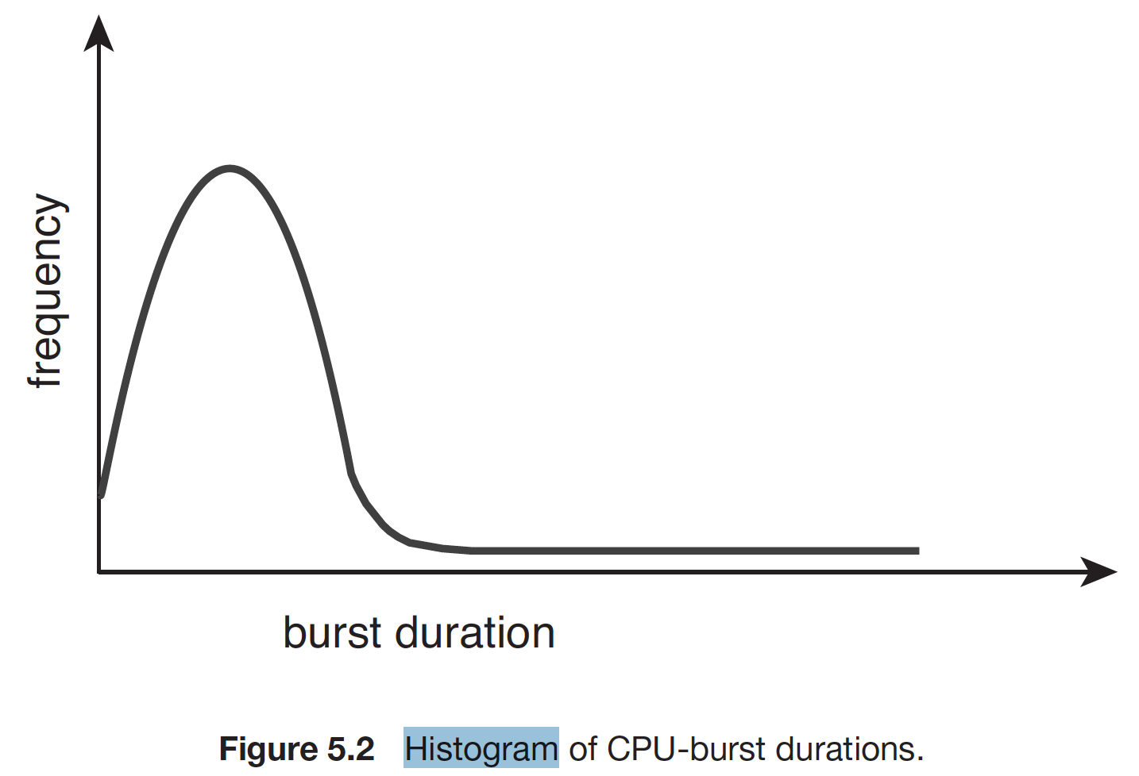
Histogram of CPU-burst Times
CPU or IO bound:
Different scheduling?

Slide 8
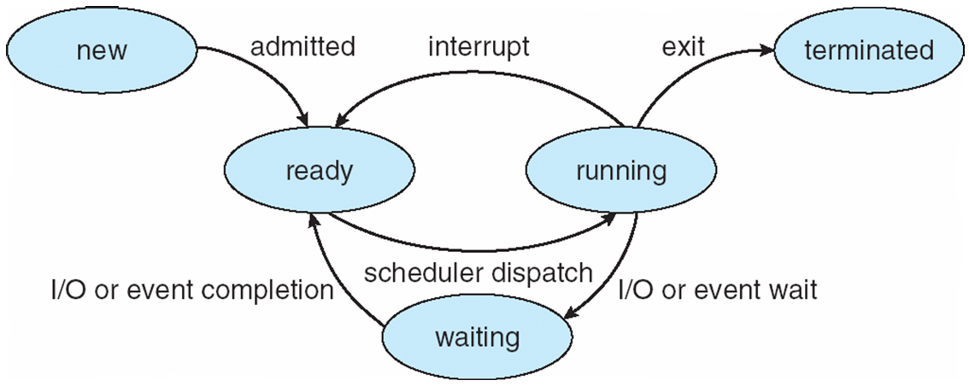
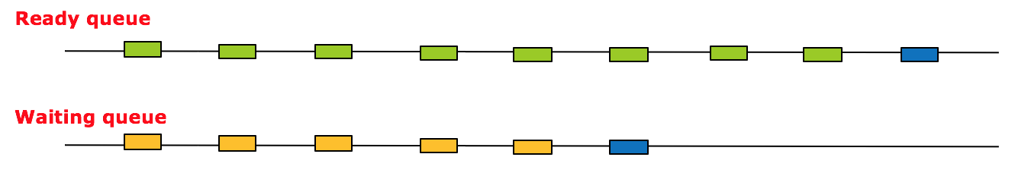
When scheduling happens
1
6
2&3
5
4
CPU
(head)

Slide 9
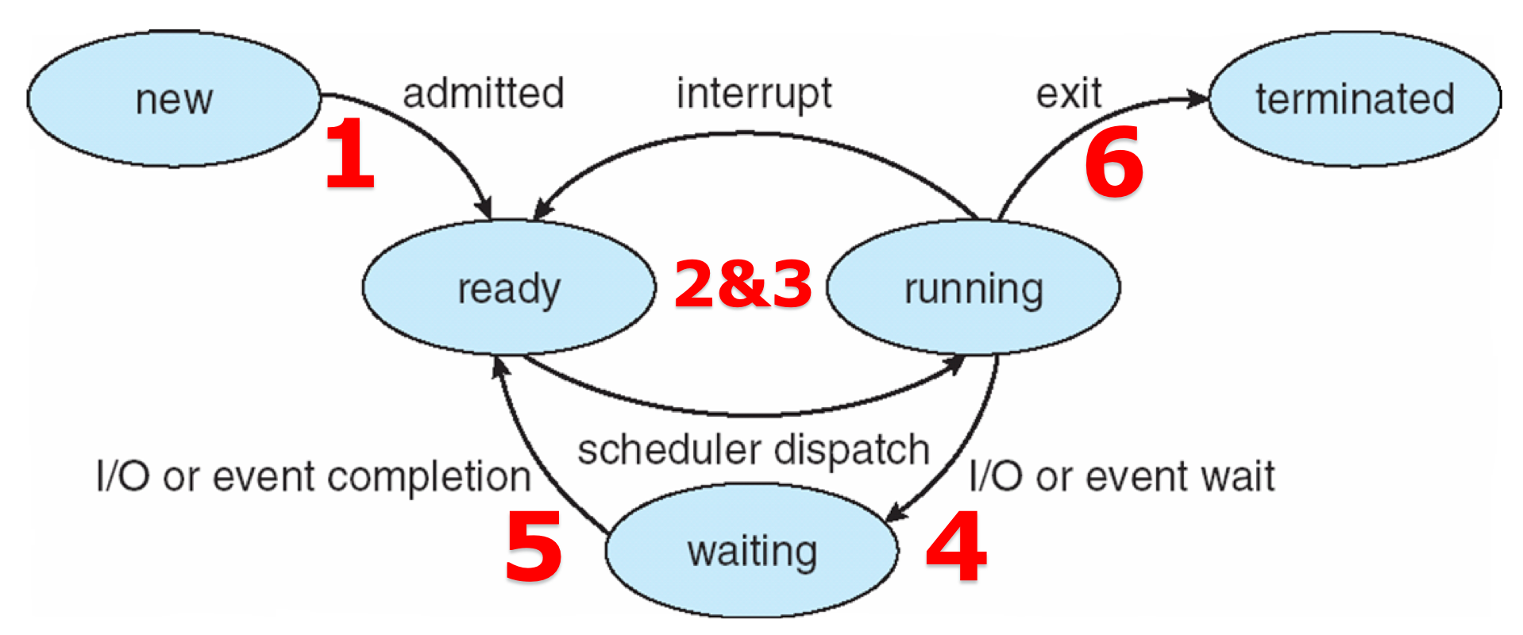
Preemptive or Non-preemptive
Scheduling under 4 and 6 is non-preemptive
All other scheduling is preemptive
Notes:
vmstat 1 3
cat /proc/[pid]/status
printf() ??? (demo?)

Slide 10
Dispatcher
Scheduler
Select
Dispatch
Dispatcher
switching context
switching to user mode
jumping to the proper location in the user program to restart that program

Slide 11
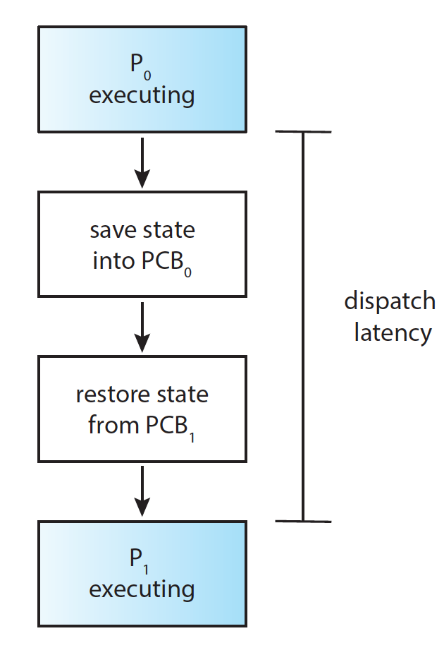
Dispatcher Latency
Dispatch latency – time it takes for the dispatcher to stop one process and start another running

Slide 12
Scheduling Criteria
CPU utilization – keep the CPU as busy as possible
Throughput – # of processes that complete their execution per time unit
Turnaround time – amount of time to execute a particular process
Waiting time – amount of time a process has been waiting in the ready queue
Response time – amount of time it takes from when a request was submitted until the first response is produced

Slide 13
Scheduling Algorithm Optimization Criteria
Max CPU utilization
Max throughput
Min turnaround time
Min waiting time
Min response time
Optimize
Average
Maximum/minimum
Variance

Slide 14
Scheduling Algorithms
One CPU burst
Average waiting time
Algorithms
FCFS (first come first served)
SJF (shortest job first)
PRI (priority)
RR (round robin)
MQ (multi-level queue)
RT (real time): RM, EDF

Slide 15
First-Come, First-Served (FCFS) Scheduling
Suppose that the processes arrive in the order: P₁ , P₂ , P₃
The Gantt Chart for the schedule is:
Waiting time for P₁ = 0; P₂ = 24; P₃ = 27
Average waiting time: (0 + 24 + 27)/3 = 17

Slide 16
FCFS Scheduling (Cont.)
Suppose that the processes arrive in the order:
P₂ , P₃ , P₁
The Gantt chart for the schedule is:
Waiting time for P₁ = 6; P₂ = 0; P₃ = 3
Average waiting time: (6 + 0 + 3)/3 = 3
Much better than previous case
Convoy effect - short process behind long process
Consider one CPU-bound and many I/O-bound processes

Slide 17
FCFS Scheduling (Cont.)
Convoy effect - short process behind long process
Consider one CPU-bound and many I/O-bound processes

Slide 18
Shortest-Job-First (SJF) Scheduling
Associate with each process the length of its CPU burst
Use these lengths to schedule the process with the shortest time
SJF is optimal – gives minimum average waiting time for a given set of processes
The difficulty is knowing the length of the next CPU request
Could ask the user

Slide 19
Example of SJF
Average waiting time = (3 + 16 + 9 + 0) / 4 = 7

Slide 20
Shortest-Job-First (SJF) Scheduling
SJF is optimal – gives minimum average waiting time for a given set of processes
proof
The difficulty is knowing the length of the next CPU request

Slide 21
Priority Scheduling: low number higher priority
A priority number (integer) is associated with each process
avg_wait

Slide 22
Priority Scheduling
The CPU is allocated to the process with the highest priority (smallest integer ≡ highest priority)
Preemptive
Non-preemptive
Problem ≡ Starvation – low priority processes may never execute
Solution ≡ Aging – as time progresses increase the priority of the process
Rumor has it that when they shut down the IBM 7094 at MIT in 1973, they found a low-priority process that had been submitted in 1967 and had not yet been run.

Slide 23
Round Robin (RR)
Each process gets a small unit of CPU time (time quantum/slice q), usually 10-100 milliseconds. After this time has elapsed, the process is preempted and added to the end of the ready queue.
Timer interrupts every quantum to schedule next process

Slide 24
Example of RR with Time Quantum = 4

Slide 25
Performance of RR
Performance
Typically, higher average turnaround than SJF, but better response
q large ⇒ FIFO
q small ⇒ q must be large with respect to context switch, otherwise overhead is too high
q usually 10ms to 100ms, context switch < 10 usec
Rule of thumb: 80% of CPU bursts should be shorter than q

Slide 26
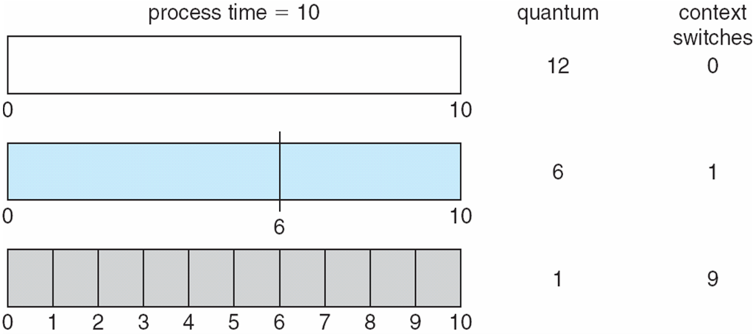
Time Quantum and Context Switch Time

Slide 27
Multilevel Queue
Ready queue is partitioned into separate queues, eg:
foreground (interactive)
background (batch)
Process permanently in a given queue
Each queue has its own scheduling algorithm:
foreground – RR
background – FCFS

Slide 28
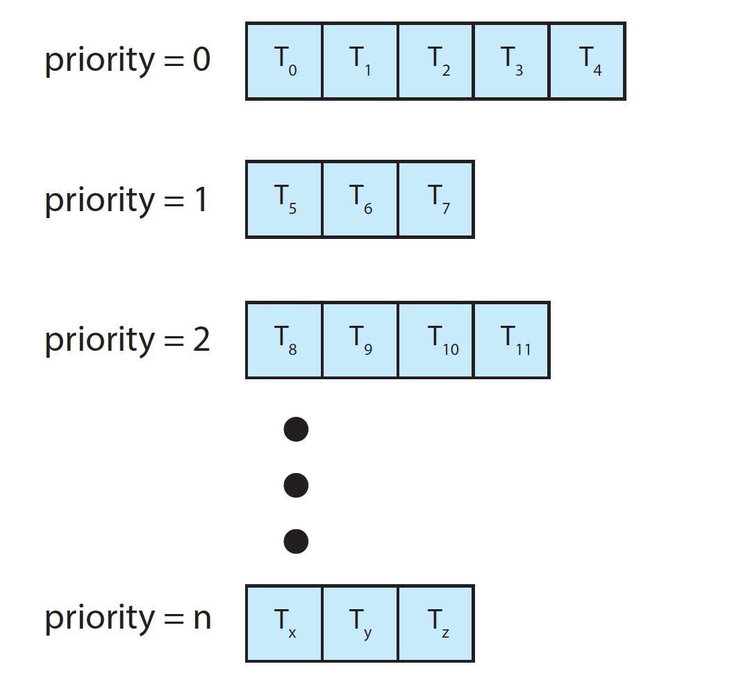
Separate Queues for Each Priority

Slide 29
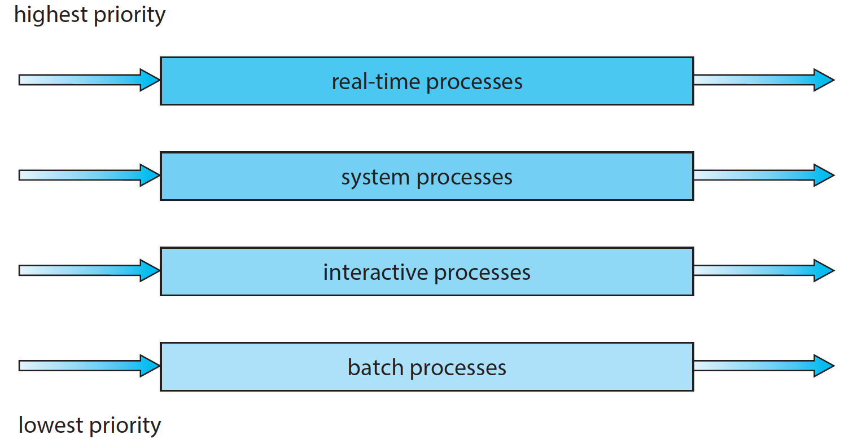
Multilevel Queue Scheduling

Slide 30
Multilevel Queue
Scheduling must be done between the queues:
Fixed priority scheduling
i.e., serve all from foreground then from background
Possibility of starvation.
Time slice
each queue gets a certain amount of CPU time which it can schedule amongst its processes; i.e.
80% to foreground in RR, 20% to background in FCFS

Slide 31
Multilevel Feedback Queue
A process can move between the various queues; aging can be implemented this way
Multilevel-feedback-queue scheduler defined by the following parameters:
number of queues
scheduling algorithms for each queue
method used to determine when to upgrade a process
method used to determine when to demote a process
method used to determine which queue a process will enter when that process needs service

Slide 32
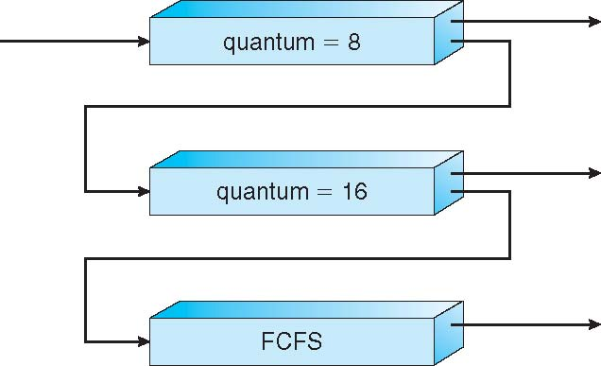
Example of Multilevel Feedback Queue
Three queues:
Q₀ – RR with time quantum 8 milliseconds
Q₁ – RR time quantum 16 milliseconds
Q₂ – FCFS
Scheduling
A new job enters queue Q₀
When it gains CPU, job receives 8 milliseconds
If it does not finish in 8 milliseconds, job is moved to queue Q₁
At Q₁ job receives 16 additional milliseconds
If it still does not complete, it is preempted and moved to queue Q₂

Slide 33
Real Time CPU Scheduling

Slide 34
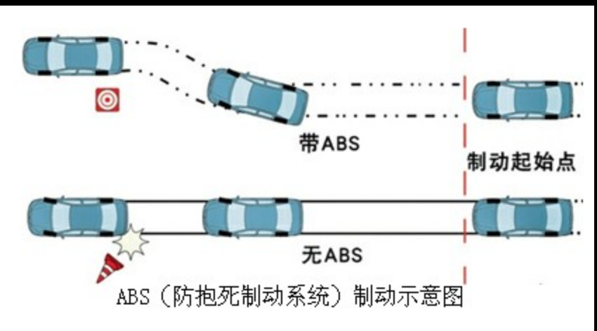
Antilock
Antilock brake system might be 3 to 5 milliseconds. That is, from the time a wheel first detects that it is sliding, the system controlling the antilock brakes has 3 to 5milliseconds to respond to and control.

Slide 35
Real-Time CPU Scheduling
Can present obvious challenges
Soft real-time systems – no guarantee as to when critical real-time process will be scheduled
Hard real-time systems – task must be serviced by its deadline
Two types of latencies affect performance (event latency)
Interrupt latency – time from arrival of interrupt to start of routine that services interrupt
Dispatch latency – time for schedule to take current process off CPU and switch to another

Slide 36
Interrupt Latency

Slide 37
Dispatch Latency

Slide 38
Real-Time CPU Scheduling (Cont.)
Conflict phase of dispatch latency:
Preemption of any process running in kernel mode
Release by low-priority process of resources needed by high-priority processes

Slide 39
Priority-based Scheduling
For real-time scheduling, scheduler must support preemptive, priority-based scheduling
But only guarantees soft real-time
For hard real-time must also provide ability to meet deadlines

Slide 40
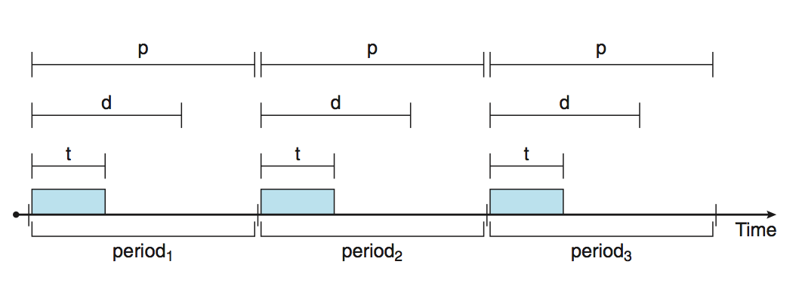
Priority-based Scheduling
Processes have new characteristics: periodic ones require CPU at constant intervals
Has processing time t, deadline d, period p
0 ≤ t ≤ d ≤ p
Rate of periodic task is 1/p

Slide 41
Rate Monotonic Scheduling
A priority is assigned based on the inverse of its period
Shorter periods = higher priority
Longer periods = lower priority
 | period | execution time
P1 | 50 | 20
P2 | 100 | 35
Notes:
P1: p=50，t=20
P2: p=100, t=35
deadline＝period

Slide 42
Rate Montonic Scheduling
 | period | execution time
P1 | 50 | 20
P2 | 100 | 35
 | P1
 | P2
0 | 10 | 20 | 30 | 40 | 50 | 60 | 70 | 80 | 90 | 100 | 110 | 120 | 130 | 140 | 150 | 160 | 170 | 180 | 190
Notes:
P1: p=50，t=20
P2: p=100, t=35
deadline＝period

Slide 43
Rate Montonic Scheduling
 | period | execution time
P1 | 50 | 20
P2 | 100 | 35
 | P1
 | P2
0 | 10 | 20 | 30 | 40 | 50 | 60 | 70 | 80 | 90 | 100 | 110 | 120 | 130 | 140 | 150 | 160 | 170 | 180 | 190
Notes:
P1: p=50，t=20
P2: p=100, t=35
deadline＝period

Slide 44
Rate Montonic Scheduling
 | period | execution time
P1 | 50 | 20
P2 | 100 | 35
 | P1
 | P2
0 | 10 | 20 | 30 | 40 | 50 | 60 | 70 | 80 | 90 | 100 | 110 | 120 | 130 | 140 | 150 | 160 | 170 | 180 | 190
Notes:
P1: p=50，t=20
P2: p=100, t=35
deadline＝period

Slide 45
Rate Montonic Scheduling
 | period | execution time
P1 | 50 | 20
P2 | 100 | 35
 | P1
 | P2
0 | 10 | 20 | 30 | 40 | 50 | 60 | 70 | 80 | 90 | 100 | 110 | 120 | 130 | 140 | 150 | 160 | 170 | 180 | 190
Notes:
P1: p=50，t=20
P2: p=100, t=35
deadline＝period

Slide 46
Rate Montonic Scheduling
 | period | execution time
P1 | 50 | 20
P2 | 100 | 35
 | P1
 | P2
0 | 10 | 20 | 30 | 40 | 50 | 60 | 70 | 80 | 90 | 100 | 110 | 120 | 130 | 140 | 150 | 160 | 170 | 180 | 190
Notes:
P1: p=50，t=20
P2: p=100, t=35
deadline＝period

Slide 47
Missed Deadlines with RM
 | period | execution time
P1 | 50 | 25
P2 | 80 | 35
 | P1
 | P2
0 | 10 | 20 | 30 | 40 | 50 | 60 | 70 | 80 | 90 | 100 | 110 | 120 | 130 | 140 | 150 | 160 | 170 | 180 | 190
Notes:
P1: p=50，t=25
P2: p=80，t=35
Deadline = period

Slide 48
Missed Deadlines with RM
 | period | execution time
P1 | 50 | 25
P2 | 80 | 35
 | P1
 | P2
0 | 10 | 20 | 30 | 40 | 50 | 60 | 70 | 80 | 90 | 100 | 110 | 120 | 130 | 140 | 150 | 160 | 170 | 180 | 190
Notes:
P1: p=50，t=25
P2: p=80，t=35
Deadline = period

Slide 49
Missed Deadlines with RM
 | period | execution time
P1 | 50 | 25
P2 | 80 | 35
 | P1
 | P2
0 | 10 | 20 | 30 | 40 | 50 | 60 | 70 | 80 | 90 | 100 | 110 | 120 | 130 | 140 | 150 | 160 | 170 | 180 | 190
Notes:
P1: p=50，t=25
P2: p=80，t=35
Deadline = period

Slide 50
Missed Deadlines with RM
 | period | execution time
P1 | 50 | 25
P2 | 80 | 35
 | P1
 | P2
0 | 10 | 20 | 30 | 40 | 50 | 60 | 70 | 80 | 90 | 100 | 110 | 120 | 130 | 140 | 150 | 160 | 170 | 180 | 190
Notes:
P1: p=50，t=25
P2: p=80，t=35
Deadline = period

Slide 51
Missed Deadlines with RM
 | period | execution time
P1 | 50 | 25
P2 | 80 | 35
 | P1
 | P2
0 | 10 | 20 | 30 | 40 | 50 | 60 | 70 | 80 | 90 | 100 | 110 | 120 | 130 | 140 | 150 | 160 | 170 | 180 | 190
Notes:
P1: p=50，t=25
P2: p=80，t=35
Deadline = period

Slide 52
RM Schedulability Test: sufficient
 | period | execution time
P1 | 50 | 20
P2 | 100 | 35
$$\sum_{i=1}^{N}{\frac{t_{i}}{p_{i}}}≤N(2^{1/N}−1)$$
 | period | execution time
P1 | 50 | 25
P2 | 80 | 35
N: number of processes
t_{i}: processing time
p_{i}: period
Notes:
N: number of processes
t_{i}: processing time
p_{i}: period

Slide 53
Earliest Deadline

Slide 54
Earliest Deadline First Scheduling (EDF)
Priorities are assigned according to deadlines: the earlier the deadline, the higher the priority;
the later the deadline, the lower the priority
 | period | execution time
P1 | 50 | 25
P2 | 80 | 35
Notes:
P1: p=50，t=25
P2: p=80，t=35
deadline = period

Slide 55
EDF
 | period | execution time
P1 | 50 | 25
P2 | 80 | 35
 | P1
 | P2
0 | 10 | 20 | 30 | 40 | 50 | 60 | 70 | 80 | 90 | 100 | 110 | 120 | 130 | 140 | 150 | 160 | 170 | 180 | 190
Notes:
P1: p=50，t=25
P2: p=80，t=35
Deadline = period

Slide 56
EDF
 | period | execution time
P1 | 50 | 25
P2 | 80 | 35
 | P1
 | P2
0 | 10 | 20 | 30 | 40 | 50 | 60 | 70 | 80 | 90 | 100 | 110 | 120 | 130 | 140 | 150 | 160 | 170 | 180 | 190
Notes:
P1: p=50，t=25
P2: p=80，t=35
Deadline = period

Slide 57
EDF
 | period | execution time
P1 | 50 | 25
P2 | 80 | 35
 | P1
 | P2
0 | 10 | 20 | 30 | 40 | 50 | 60 | 70 | 80 | 90 | 100 | 110 | 120 | 130 | 140 | 150 | 160 | 170 | 180 | 190
Notes:
P1: p=50，t=25
P2: p=80，t=35
Deadline = period

Slide 58
EDF
 | period | execution time
P1 | 50 | 25
P2 | 80 | 35
 | P1
 | P2
0 | 10 | 20 | 30 | 40 | 50 | 60 | 70 | 80 | 90 | 100 | 110 | 120 | 130 | 140 | 150 | 160 | 170 | 180 | 190
Notes:
P1: p=50，t=25
P2: p=80，t=35
Deadline = period

Slide 59
EDF
 | period | execution time
P1 | 50 | 25
P2 | 80 | 35
 | P1
 | P2
0 | 10 | 20 | 30 | 40 | 50 | 60 | 70 | 80 | 90 | 100 | 110 | 120 | 130 | 140 | 150 | 160 | 170 | 180 | 190
Notes:
P1: p=50，t=25
P2: p=80，t=35
Deadline = period

Slide 60
EDF
 | period | execution time
P1 | 50 | 25
P2 | 80 | 35
 | P1
 | P2
0 | 10 | 20 | 30 | 40 | 50 | 60 | 70 | 80 | 90 | 100 | 110 | 120 | 130 | 140 | 150 | 160 | 170 | 180 | 190
Notes:
P1: p=50，t=25
P2: p=80，t=35
Deadline = period

Slide 61
EDF
 | period | execution time
P1 | 50 | 25
P2 | 80 | 35
 | P1
 | P2
0 | 10 | 20 | 30 | 40 | 50 | 60 | 70 | 80 | 90 | 100 | 110 | 120 | 130 | 140 | 150 | 160 | 170 | 180 | 190
Notes:
P1: p=50，t=25
P2: p=80，t=35
Deadline = period

Slide 62
EDF
 | period | execution time
P1 | 50 | 25
P2 | 80 | 35
 | P1
 | P2
0 | 10 | 20 | 30 | 40 | 50 | 60 | 70 | 80 | 90 | 100 | 110 | 120 | 130 | 140 | 150 | 160 | 170 | 180 | 190
Notes:
P1: p=50，t=25
P2: p=80，t=35
Deadline = period

Slide 63
EDF
 | period | execution time
P1 | 50 | 25
P2 | 80 | 35
 | P1
 | P2
0 | 10 | 20 | 30 | 40 | 50 | 60 | 70 | 80 | 90 | 100 | 110 | 120 | 130 | 140 | 150 | 160 | 170 | 180 | 190
Notes:
P1: p=50，t=25
P2: p=80，t=35
Deadline = period

Slide 64
EDF Schedulability Test: iff
$$\sum_{i=1}^{N}{\frac{t_{i}}{p_{i}}}≤1$$
 | period | execution time
P1 | 50 | 25
P2 | 80 | 35
N: number of processes
t_{i}: processing time
p_{i}: period

Slide 65
End of Chapter 5

